Slide 1
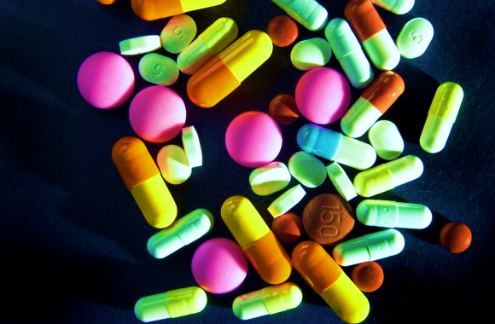
PHARMACEUTICAL SECTOR IN KENYA.
Access to and affordability of essential medicines in Kenya

Slide 2
INTRODUCTION
Developing the pharmaceutical manufacturing sector is a core part of building a progressive and sustainable health-care system that can respond to routine needs and emergencies.
In this analysis, we explore the current state of the pharmaceutical industry within Kenyan Pharmaceutical Sector across 47 Counties focusing on trends, challenges, and opportunities for growth.
Our goal is to:
The data will offer valuable insights for stakeholders in the health sector, policy-makers, and investors interested in improving pharmaceutical accessibility across the country.
1
Compare access to essential medicine
Analyze trends in cost of medicine
Relation with insurance.
Examine relationship between government spending and chronic illness.
4
Examine counterfeit drug cases
Relations to import
3
2

Slide 3
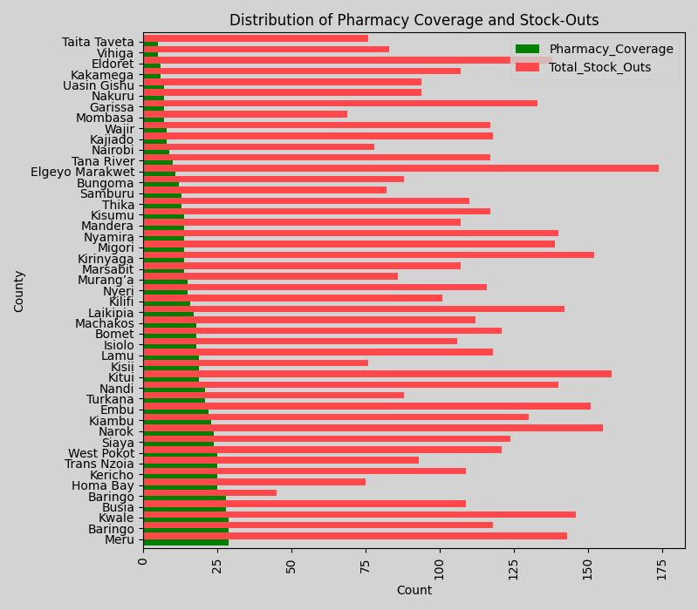
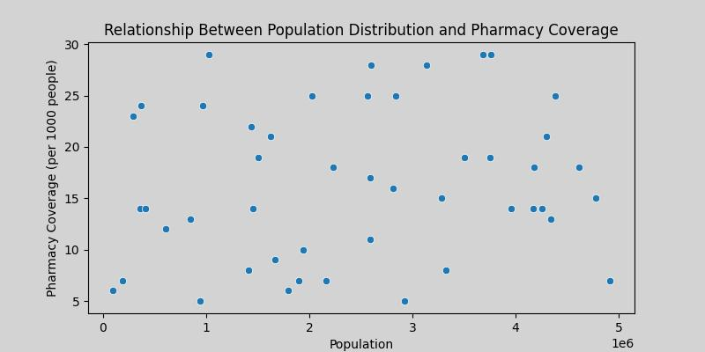
Access to essential medicines across counties
Stock-outs significantly exceed pharmacy coverage
Significant disparities in access to essential medicines, healthcare infrastructure, and pharmaceutical services
Eg Rural vs Urban.
Population size is not the primary factor influencing the availability of pharmacies

Slide 4
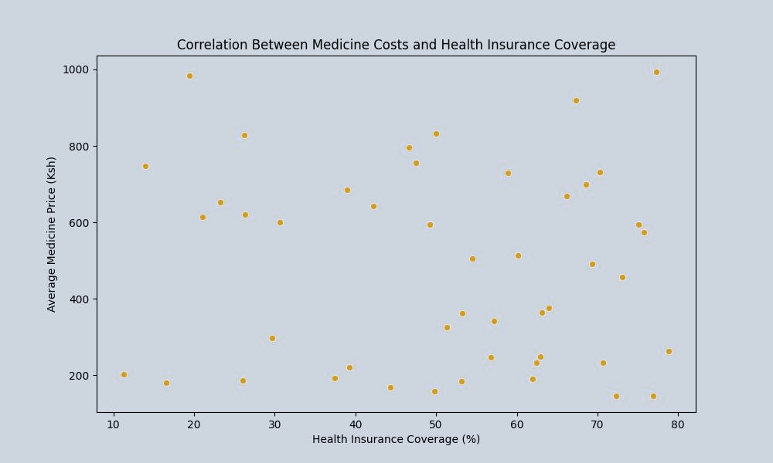
Trends in the cost of medicines
Medicine prices vary widely, with some medicines priced as low as close to 100 Ksh (146 )and others reaching close to Ksh 1000.(993)
There are two main price ranges where medicine prices are concentrated, around Ksh 200–300 and Ksh 600–700
There is no relationship between medical prices and health coverage insurance.

Slide 5
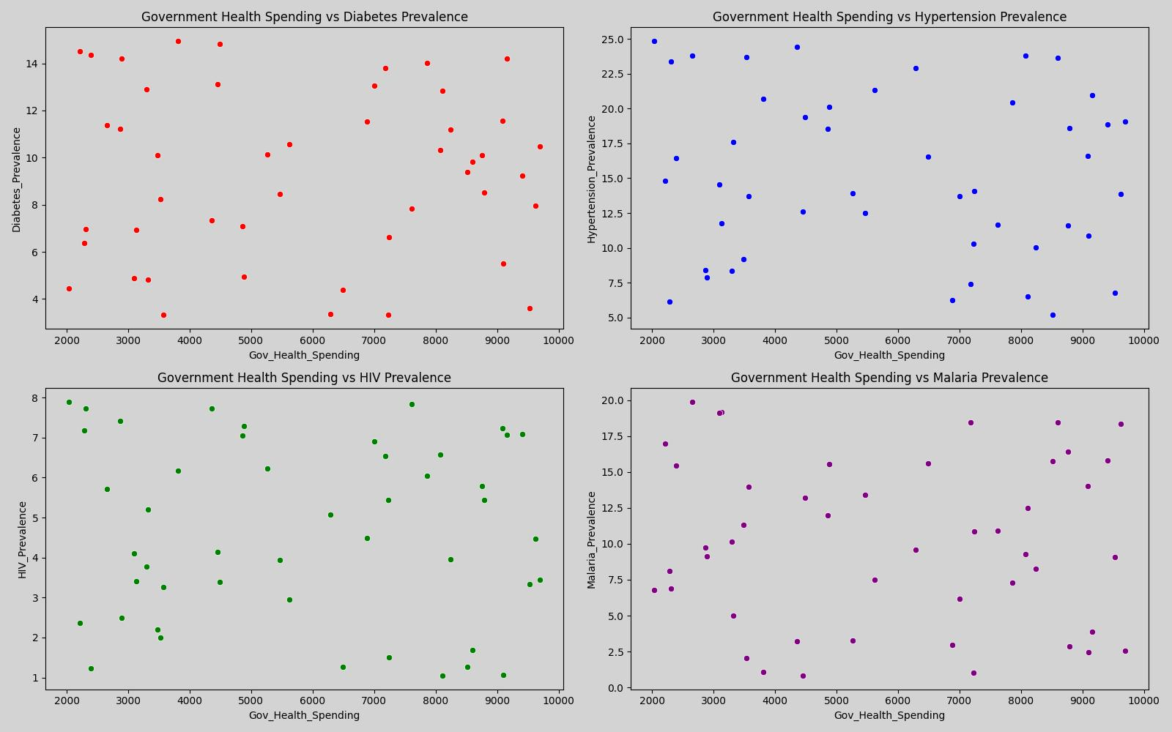
Relationship between government health spending and chronic illness prevalence
 | Gov-Spending | Diabetes | Hypertension | HIV | Malaria
Gov-Spending | 1 | 0.002665637 | -0.104961 | -0.0492764 | -0.04233
Diabetes | 0.002665637 | 1 | -0.073952 | -0.046904 | -0.0068
Hypertension | -0.104960955 | -0.073951735 | 1 | 0.28553574 | -0.10117
HIV | -0.049276421 | -0.046903963 | 0.2855357 | 1 | -0.18153
Malaria | -0.04232854 | -0.006801033 | -0.101174 | -0.1815306 | 1
It’s possible that other factors like healthcare delivery efficiency, lifestyle changes, environmental factors, or access to specific programs are more crucial in controlling chronic illness rates than general spending alone.
Increased government health spending has little to no direct impact on chronic illness

Slide 6
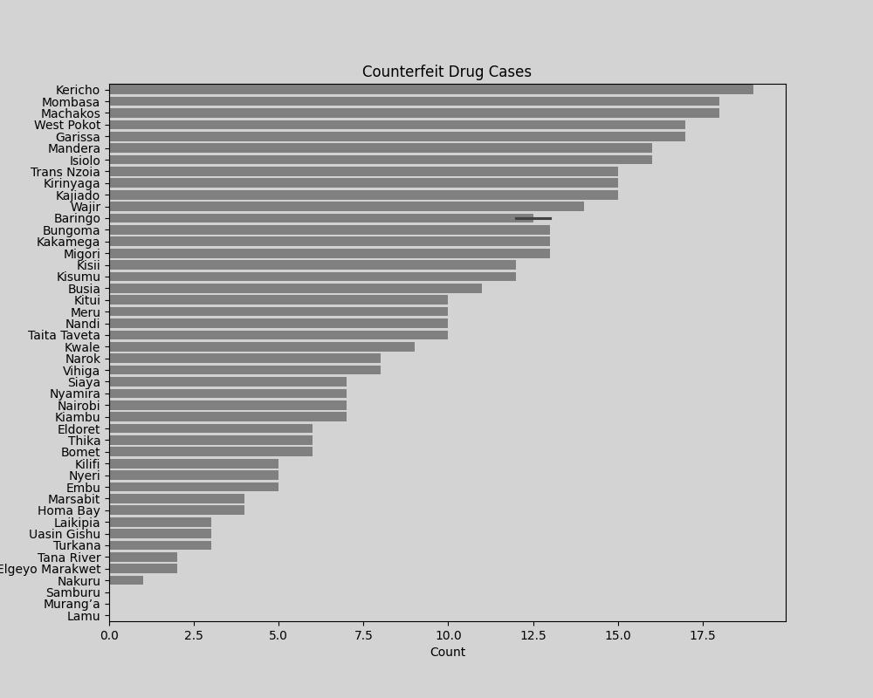
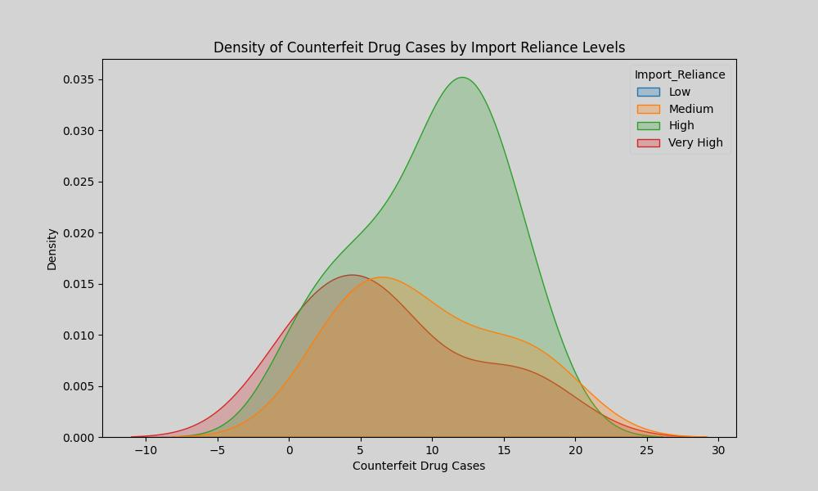
Patterns in counterfeit drug cases and how they relate to import reliance.
High import reliance is associated with more frequent counterfeit drug cases, while low import reliance counties have fewer issues.
Imports should increase regulation at very high reliance levels or more stringent checks on imports.

Slide 7
CONCLUSION
There is no relationship between medical prices and health coverage insurance.
Increased government health spending has little to no direct impact on chronic illness
Stock-outs significantly exceed pharmacy coverage
1
3
5
2
4
Significant disparities in access to essential medicines, healthcare infrastructure, and pharmaceutical services
High import reliance is associated with more frequent counterfeit drug cases, while low import reliance counties have fewer issues

Slide 8
RECOMENDATIONS
Strengthen Pharmaceutical Supply Chains
Regulatory Framework and Policy Reforms
Encourage Public-Private Partnerships
Capacity Building and Training
Promote Local pharmaceutical manufacturing.

Slide 9
Q & A?

